Slide 1


Concrete Syntax for a UML Action Language
Second Revised Submission of the
Action Language for Foundational UML (Alf)

Slide 2







Submitters and Supporters
Model Driven Solutions
Mentor Graphics
88solutions Corporation
No Magic
International Business Machines
Visumpoint (supporter)
Ericsson (supporter)
CEA (supporter)
Thales (supporter)

Slide 3
Agenda
History
Purpose and Scope
Design Principles
Second Revised Submission
Adoption Recommendation Vote

Slide 4
History
RFP Issued 26 September 2008
Initial Submissions 17 August 2009
  Two submissions
Revised Submission 15 February 2010
  One joint submission
Evaluation WG Report 23 June 2010
  Favorable evaluation
Second Revised Submission 23 August 2010

Slide 5
Purpose and Scope
From the RFP:
“This request therefore solicits proposals for a concrete syntax for a textual UML Action Language for the action model incorporated into fUML that will operate only at the level of abstraction of UML and which is capable of being translated into different implementations for different platforms and languages.”
“The scope of the action language is the action model of the Executable UML Foundation, including the standard model libraries for I/O and basic operations.”
“Proposals may incorporate constructs for other elements in the Executable UML Foundation that are not part of the action model, if desired.”

Slide 6
Design Principles
Provide a familiar C-legacy (“Java like”) syntax, but allow UML textual syntax when it exists .
Minimize the need for graphical models to change in order to accommodate use of the action language.
Be usable in the context of models not limited to the fUML subset.
Provide a naming system that is based on UML namespaces for referencing elements outside of an activity and a consistent use of names to reference nodes within an activity.
Allow for both explicit type declaration as well as an implicit type system based on typing declared in the structural model elements.
Provide a notation to take advantage of the underlying flow-oriented nature of activity models, with an expressivity similar to the OCL notation for collections. (optional)
Provide a concrete syntax for structural modeling (largely within the bounds of the fUML subset). (optional)

Slide 7
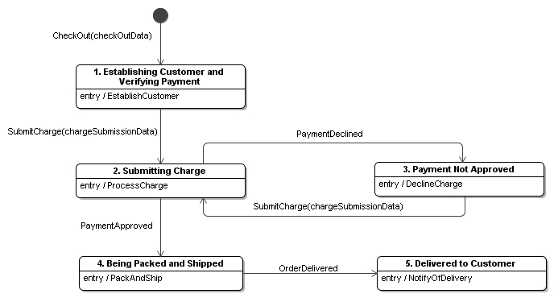
Example: Online Order
R10.createLink(this, this.checkOutData.cart);
matchingCustomers = Customer -> select c
(c.email == this.checkOutData.customerEmail);
if (matchingCustomers->isEmpty()) {
customer = new Customer(this.checkOutData);
} else {
customer = matchingCustomers[1];
customer.update(this.checkOutData);
}
R5.createLink(this, customer);
this.dateOrderPlaced = TimeUtility::GetDate();
this.SubmitCharge
(new ChargeSubmissionData(this.checkOutData));
Opaque Behavior

Slide 8
Planned for Second Revised Submission
Support additional features
  Real/floating numeric types and functions
  Non-base 10 literals and bit manipulation operations
  Static features
  A few additional syntactic changes (link operations, reduction)
Add collection class library
  Provide familiar object-oriented collection abstractions
  Integrate with flow-oriented collection operations
Formalize the specification of the mapping to fUML
  Abstract syntax as the target for parsing of concrete syntax
  Static semantics as derivations and constraints on abstract syntax
  Mapping via QVT transformation from Alf abstract syntax to fUML abstract syntax
Add abrupt transfers of control (exceptions, break, continue)

Slide 9
Added in Second Revised Submission
Support additional features
  Real/floating numeric types and functions
  Non-base 10 literals and bit manipulation operations
  Static features
  A few additional syntactic changes (link operations, reduction)
Add collection class library
  Provide familiar object-oriented collection abstractions
  Integrate with flow-oriented collection operations
Formalize the specification of the mapping to fUML
  Abstract syntax as the target for parsing of concrete syntax
  Static semantics as derivations and constraints on abstract syntax
  Mapping via QVT transformation from Alf abstract syntax to fUML abstract syntax
Add abrupt transfers of control (exceptions, break, continue)

Slide 10
Non-Base 10 Literals and Bit Manipulation
Binary, hexadecimal and octal literals for integers
  0b0001_1101, 0x1D, 035
BitString primitive type
  Automatic conversion from Integer
Operations on bit strings
  Bit-wise logical operators
    ~ (complement), & (and), | (inclusive or), ^ (exclusive or)
  Shift operators
    < (left shift), > (signed right shift), >> (unsigned right shift)

Slide 11
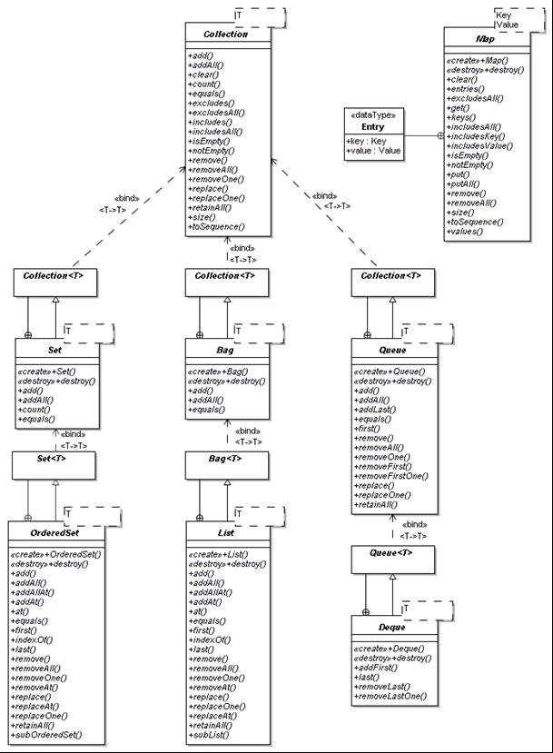
Collection Classes
Collection<T>
Map<Key,Value>
Set<T>
Bag<T>
Queue<T>
OrderedSet<T>
List<T>
Dequeue<T>

Slide 12
Other Additions
Template classifiers and operations
  Set<Integer> s = null;
  add<Integer>(s,1);
  add(s,1); (limited type inference)
Simplified forms of sequence construction and instance creation expressions for initialization
  Entry[*] list = {entry1, entry2};
  Set<Integer> s = {1, 2, 3};
  Point p = new(1,2);
  FullName n = new(first=>fn, last=>ln);
  Can also be used for attribute default values
Non-normative annex on using Alf with state machines and composite structure models

Slide 13
Adoption Recommendation Vote
Motion to vote to recommend adoption (“vote-to-vote”)
Vote to recommend adoption

